Slide 1

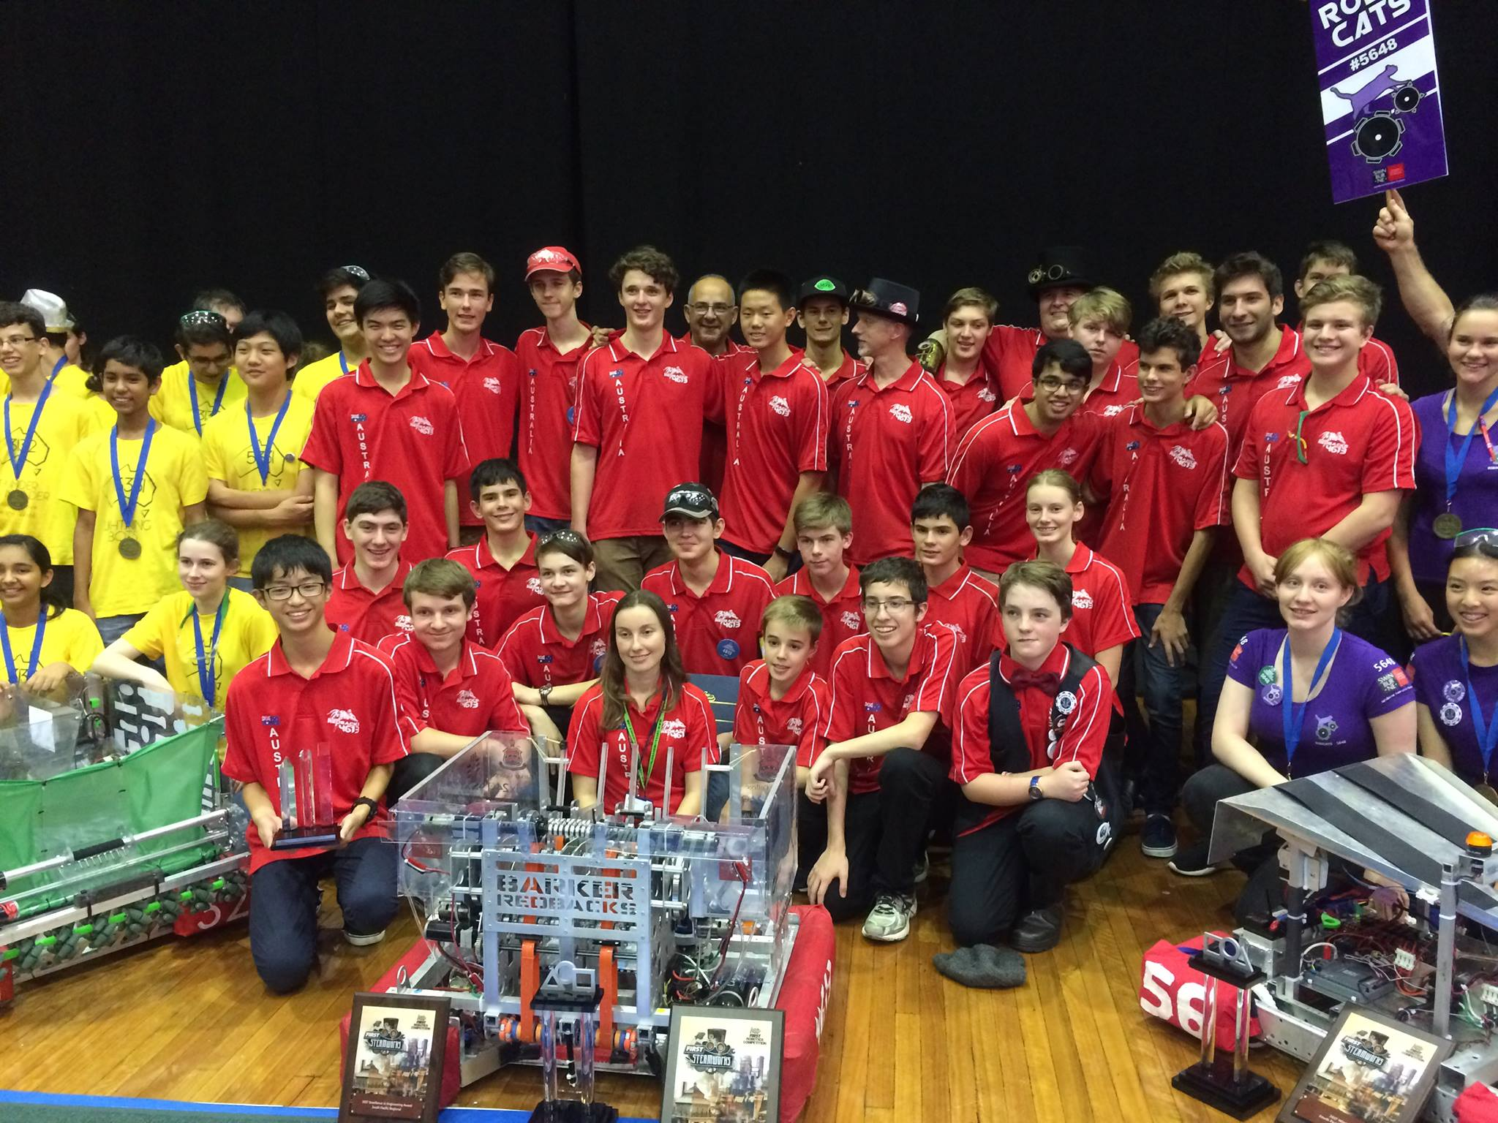
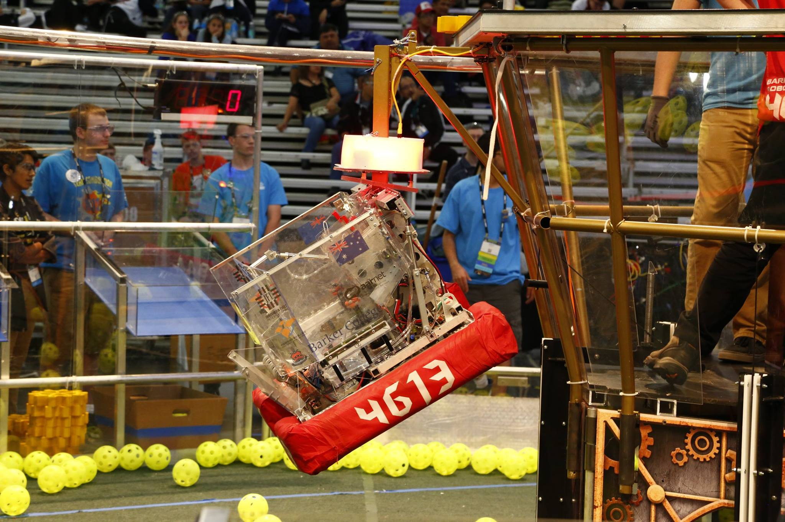
Introduction to (Java) Programming 13 – Exceptions and Error Handling
Matthew Brian

Slide 2
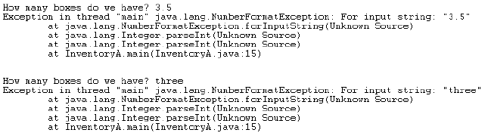
Lesson 13: Exceptions and Error Handling
Everything is all well and good so far when we are coding, but what if things take an unexpected turn for the worse? What if a user puts something into the program that you weren't expecting?
Say we are writing a bit of code to get an integer from the user and store it in an integer. What if a user inputs a decimal point number instead?

Slide 3
Lesson 13: Exceptions and Error Handling
What is really happening here when we see this exception pop up?
Well, the Java programming language has an inbuilt mechanism to work this out for you, called Exception Handling. This allows a program to detect that things are going wrong, and respond by creating a brand new Exception object. In official Java terms, if a program does this, it is throwing an exception. When a program goes wrong, like inputting a double instead of an int, it throws an exception and immediately terminates the block of code running
This is because an Exception object, once it is created, is passed as in a game of hot potato, until a piece of code decides that it wants to catch the exception
Once caught, the catcher does something to save the program from imploding (recovery code), destroys the exception, and moves on as if nothing ever happened
This is done in java using several keywords:
Throw: Creates a specified exception object, and ‘throws’ it
Throws: Passes the buck from a method up to whatever code called the method
Try: Encloses code in a block as an if statement would. Only encloses code that could potentially create an exception
Catch: Block of code that is executed if an exception is generated in the try block of code

Slide 4
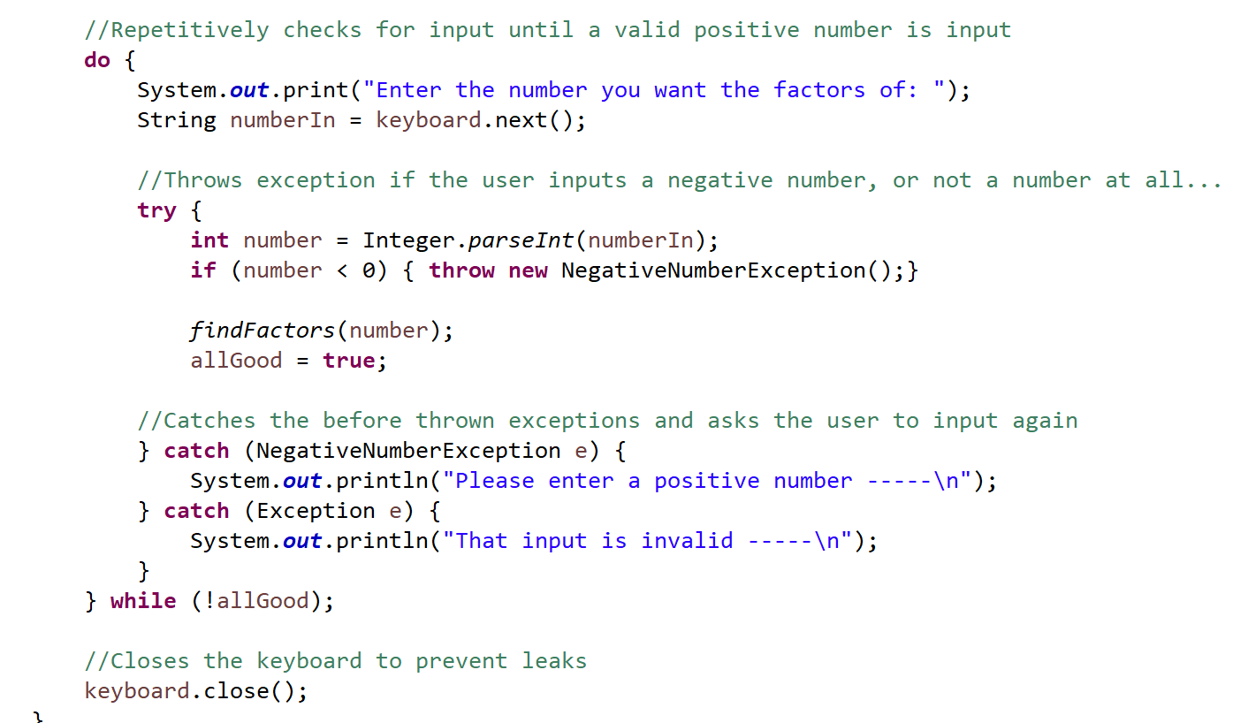
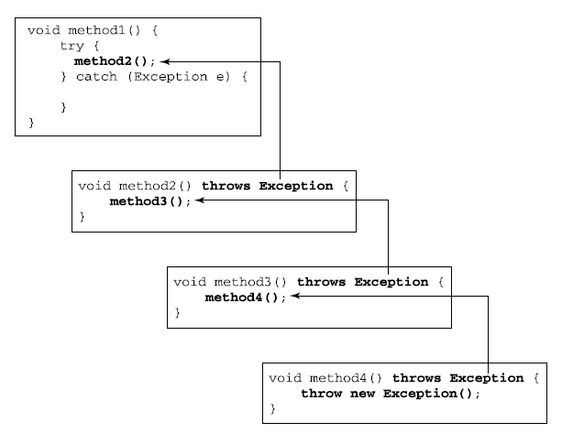
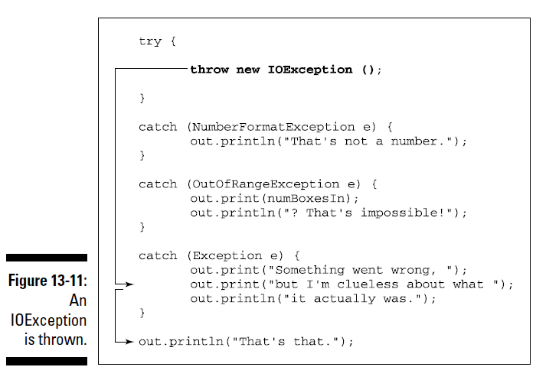
Lesson 13: Exceptions and Error Handling

Slide 5
Lesson 13: Exceptions and Error Handling
If exceptions are not caught by the programmer, each bit of code continually passes the buck up until it gets all the way up to the Java runtime, which catches all exceptions, except instead of printing something out, and continuing the code nicely, it immediately terminates all code running
You can also make your own exceptions, which I will show you about if you want me to
Also, don’t bother writing code to catch exceptions that will never be thrown by a particular block of code
Also in Java there are two types of exceptions – Checked and unchecked exceptions. Potential to throw a checked exception must be acknowledge within the code. Unchecked exceptions can be ignored safely.
You can acknowledge by either placing the possibly-exception-throwing-statement in a try-catch statement as shown before, with a matching catch clause with the correct exception type. Or you can do what is on the next page

Slide 6
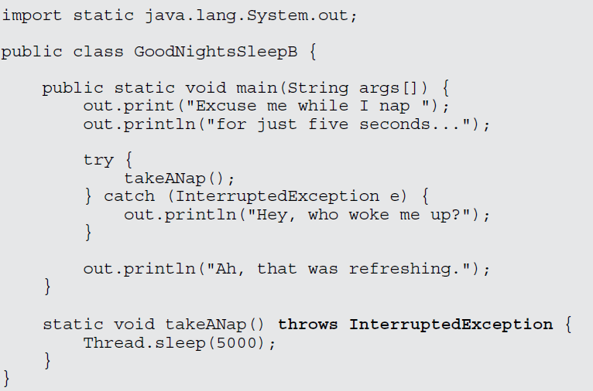
Lesson 13: Exceptions and Error Handling

Slide 7
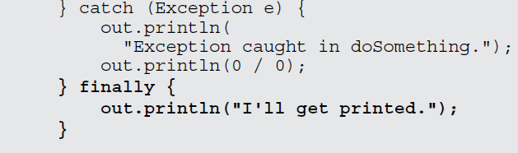
Lesson 13: Exceptions and Error Handling
There are a bunch of other funky things you can do with Exception handling to make sure that your code never crashes, I will run through one more, but leave the rest because you almost never see them
You can add a finally block of code after the last catch block of code, which is like a will. Once the code inside the try statement has died and its exception has been caught, this block of code is always executed

Slide 8

Lesson 13: Exceptions and Error Handling
Activities
Throw an exception in a bit of code somewhere (throw new Exception();)
Run the code an observe that it doesn’t work
Now add a try and catch clause around this that anticipates the exception throwing and does something
Add a few more useless catch clauses
Add a finally clause that does something once an exception has been caught
If we get time, I will now go over GitHub stuff :D

